Slide 1

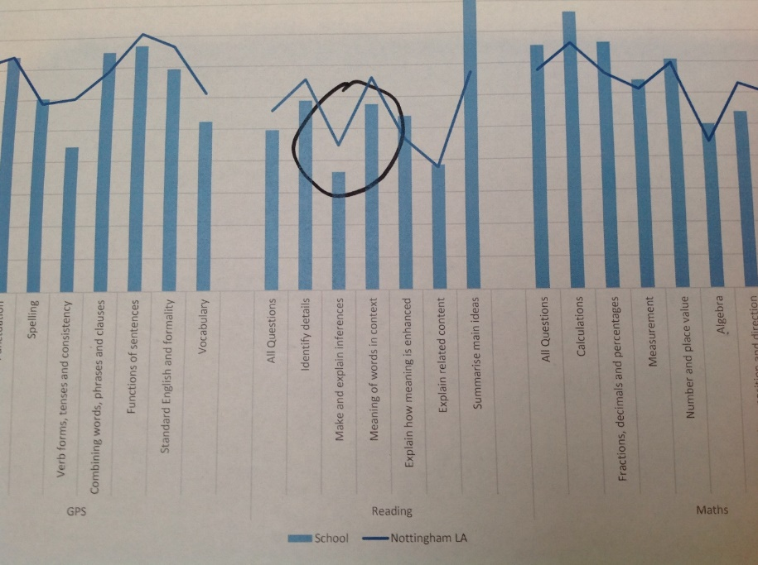
Does Broadening Vocabulary Improve Inference Skills in Children with EAL?
case study of an appeal’s project by Julie Zacharski – Eal teaching assistant
Why this Case Study?
“Vocabulary is a critical factor in the development of reading skills”. Lane & Allen 2010
Pupil Voice
There is growing evidence to suggest that the more that pupils are involved in the learning process the more effective their learning is, for example in assessment for learning, peer and self-assessment. Pupils are very aware of factors which help or hinder their learning in lessons and can play an important role in identifying them through observation. At William Booth, we use this as part of Assessment for Learning (AFL) and for our EAL learners to recognise progress in their own work in order for them to increase confidence and improve self-esteem. Through teaching different strategies and using a variety of resources, the children are gradually beginning to understand how to cope with inference style questions by using the different approaches offered to them.
This type of development work was chosen as there has been a consistent trend at William Booth that shows inferencing style questions prove to be a challenge for children with English as a second language. The data (DAISI Analysis 2017) for end of KS2 SATS results, highlights this fact when looking at the breakdown of questions from the reading paper. William Booth data – 2018 KS2 SATS: 48% of the class were classed as EAL. Of these 13 children, 5 passed the Reading test – 1 of which achieved greater depth. The current Year 6 children took the 2017 test in November 2018. 22 out of 30 children (73%) are classed as EAL. Only 6 children (27%) passed the test – based on expected pass mark in 2017. Given these findings, I decided to focus on reading as a specific curriculum area to work on. I identified a small group of current Year 6 EAL children who started school with little or no English language acquisition during Year 5. The majority of which are expected to sit end of KS2 SATS.
Success Criteria
The success criteria was for the pupils to draw upon the taught strategies, use them effectively within the classroom (non-intervention) and during their end of KS2 exams. Assessment for Learning played a big part in the pupil’s progression. By using considered teacher questioning and feedback, the children began to be more confident in self-assessment and peer assessing therefore empowering them to evaluate their own progress. Giving opportunities for group discussions enabled the children to explore language and ideas, helping them to move from concrete to abstract thinking.
Intention of Impact
CPD, Research and Own Experience Drawn Upon
The intention of impact on pupil learning was to encourage the pupils to explore and be immersed in a greater range of vocabulary and different learning strategies to enable a more confident approach when tackling inference questions.
Own subject knowledge
Own ability to deliver tuition for Year 6 SATs preparation
Drawing upon systemic functional grammar within sessions
Internal school CPD around vocabulary/reading
APEALs information and training
Internet research around reading and inferencing
Using Assessment for Learning (AFL) to drive progress
“The impact of the project on this targeted group of EAL learners has been extremely positive. The children have effectively applied many of the taught strategies and approaches independently in class during reading sessions. The clear immersion in vocabulary and rapid development in this area has meant these children are able to access higher-level texts and identify the meaning of specific (often Tier-2) words as well understanding the text in a wider sense. This has, in turn, improved their inference skills enabling them to draw on experiences to find missing details across a range of texts - this has been demonstrated in class and on test papers.” Class 6 Teacher & School Leadership Team

Slide 2
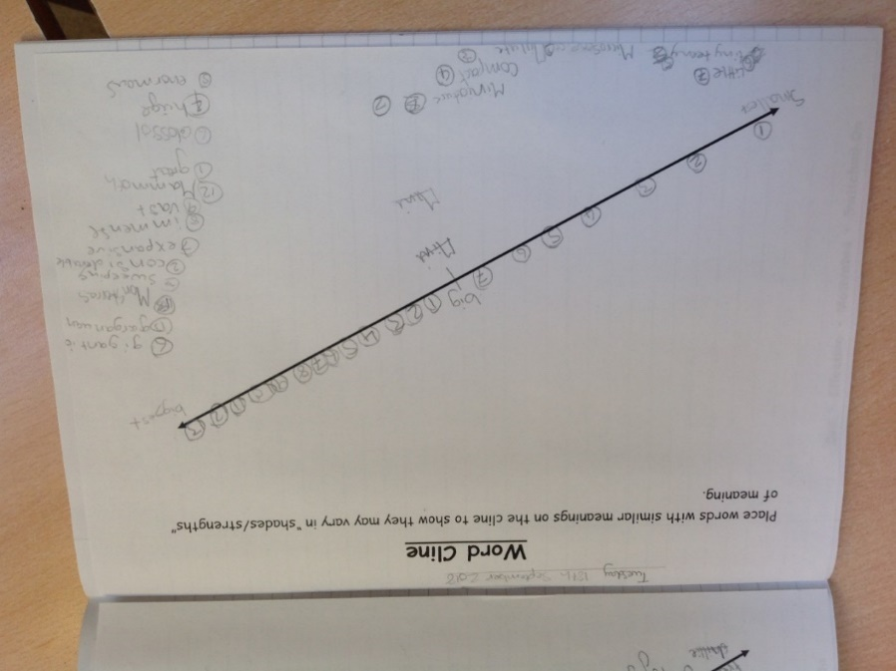
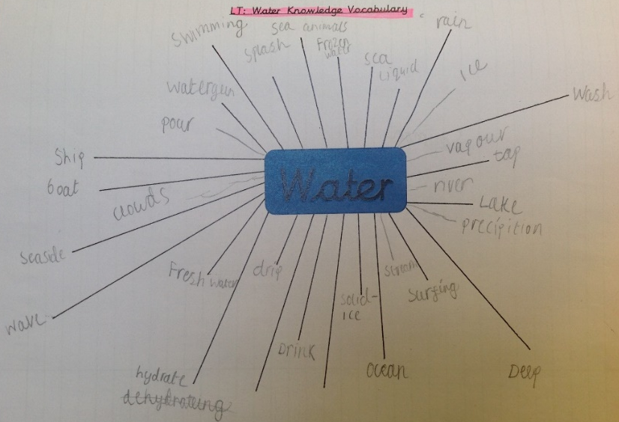
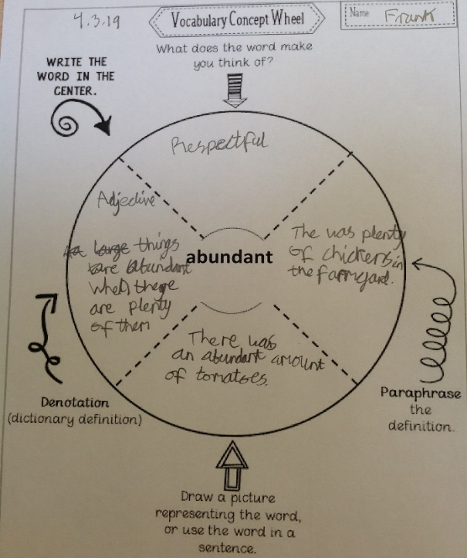
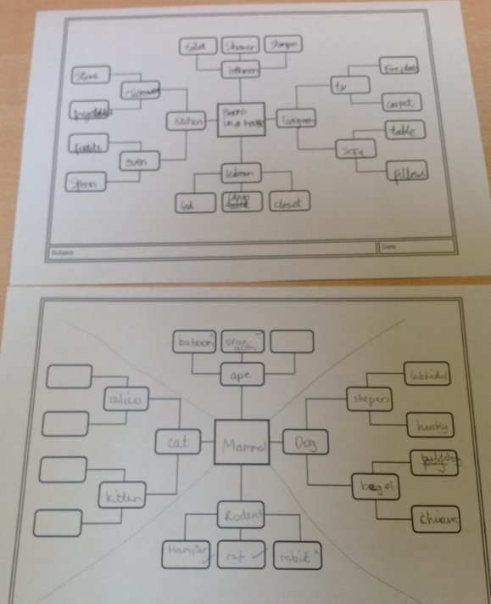

Teaching Approaches (Pedagogy) and Resources
Common Misconceptions
Vocabulary, vocabulary, vocabulary…
Word association nets
Clines for shades of meaning
Synonyms and antonyms
Superordinates and hyponyms
Drawing inferences – scaffolded and unscaffolded
Vocabulary concept wheel
A variety of different text genres
Vocab Ninja
Word exploration
Word wall
An inference does not need to be “correct” to be valid. Often teachers dismiss a guess if it does not match his or her expectations for what students should know. Learners will be using their inference skills if they can justify their reasoning.
Assuming that learners have had the same experiences, immersion in a wide range of text genres and have the vocabulary in English to make links between facts and reasoning.
Key Messages for Other Practitioners
Don’t be afraid to try new ways of approaching inferencing skills. Have a bank of different strategies/resources to enable the children understand and develop their own processes in order to be confident, effective and successful when inferencing. Vocabulary is the key to communication. A strong bank of vocabulary enables the development of other skills, supporting comprehension generally but inference in particular. The more words you know – the more you learn! A strong focus should be placed on Tier 2 words (high frequency words) as they are frequent in a variety of KS2 texts and are powerful due to their wide applicability. They are not as explicitly taught as Tier 3 words (more subject specific). Explicit information in a sentence or sentences, supplemented by knowledge about the world from long-term memory play a vital part in the inference process. This is essential for filling in missing details. These skills can be taught at all KS levels. The earlier the better! Use AFL to drive progress.
Sustaining Progress
In order to ensure sustainability, school must use data effectively to monitor progress which informs interventions required, strategies, planning to enable the children to make consistent progress and to meet their expectations at end of KS2.
Ensure that vocabulary continues to be a whole school priority.
Reflection: Monitor, analyse and act on data regularly in order to ensure gaps in learning are closed or narrowed.
Final Thoughts…
Having done lots of research and explored different pedagogies with the pilot group of EAL children, I personally cannot state that there is sufficient evidence to categorically prove that broadening vocabulary improves inference skills in children. I will, however, confidently quantify that developing and building upon vocabulary has undoubtedly had an extremely positive impact on the children’s Language Levels:
Confidence to explore vocabulary choices and apply them to verbal sentences.
Greater depth and understanding when tackling more inference/reasoning style reading questions
Empowerment to question and use questioning to “dig deeper” for answers
Building upon general and subject specific vocabulary leading to more specific words for precision
“Shades of meaning” for subtlety when applied to written work
Greater confidence in engagement of class discussions and verbalising reasoning
Making connections between unknown vocabulary and inferencing skills

